Slide 1
Wework.com
Student
Institution
Date

Slide 2
Essential Qualities of the Opportunity
Opportunities make organizations create a need for a product or service. The opportunities they exploit have four basic characteristics.
The opportunity must be:
Attractive,
Timely,
Durable,
Offer value to the customer's end-user.
Attractiveness is one quality or characteristic that means that the opportunity measures to the expectations of the entrepreneur. It should place the organization in a position where they get to realize the most financial gains. It helps them establish a profitable position in the market.
Timeliness is where an opportunity comes at the right time. It comes when the ideas are in place and the environment is ready for the significant shift. Timely opportunities tend to last longer and have a longer lifecycle. For example, the products become relevant in the market and last longer than the competition's products and services. The opportunity for wework.com came at a time when technology favors such a business.

Slide 3
Essential Qualities of the Opportunity
The advantages of an opportunity based on durability and value it offers the end-user include the following. This applies to the case of Wework Company.
Durability in terms of opportunities means that it can withstand both internal and external pressure. Businesses and startups don’t last long because the opportunity was not durable. Durability is what gives the opportunity advantage. In the case of wework, the opportunity is durable. The need for better office spaces is enduring.
Value to the end-user is critical to the success of the opportunity and the entire business. Wework offers value to the end-user. They get to feel that they have something worth spending their money on. For example, they are creating offices close to home. Everyone has to work but working at home can be difficult. However, if the office came closer to the employee, it would be worth the money. Consumer think of value before thinking of the price.

Slide 4
Brand Elements
Brand elements are many, and they must get made in a way that complements each other. Some of the common elements of a brand, including but not limited to:
Likeability, the company has created a brand that people love and admire. People love and respect the brand for the value and promise it offers and keeps. It incorporates the whole community with words like "better together", "make a life, not just a living", among others. Such messages send a signal to customers that the company cares and values them, and they love it in return.
Flexibility is another element that the company has explored. The logo, which is an element of the brand, can change its font, or colour or shape. When it comes to branding, customers always expect to have a human experience with the brand. They want to relate to and feel the brand. Companies achieve this quality and element by making the brand flexible. Wework realizes that flexible branding is the future and that it is the only way to maintain brand consistency.

Slide 5
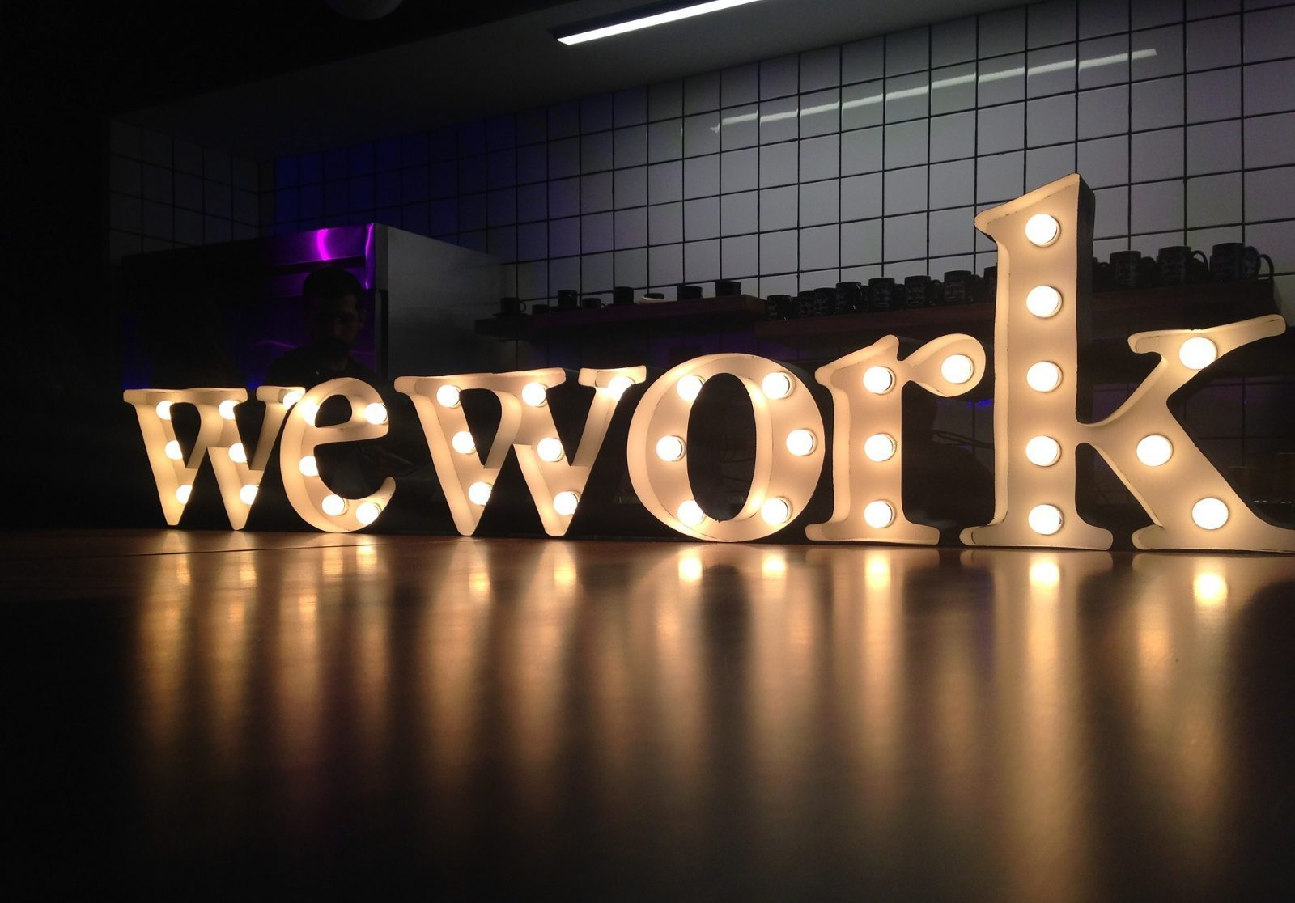
Brand Elements
Memorability is another brand element that is common with businesses. When the brand is easy to remember, it also becomes easy to recognize. That is a vital element for any organization. In the case of Wework Company, the brand is easy to remember. The initials on the logo are simple and easy to remember and recognize. The letters WC inside a circle are easy to spot even from a distance. Whenever a customer or an individual sees the initials, one thing comes to mind, Wework Company. The company is now almost in the same category as Apple and McDonalds, which have been in the market for a long time. Their few years of operation have given them the benefit of customers memorizing their brand and also the logo remaining in their mind unconsciously.

